Slide 1
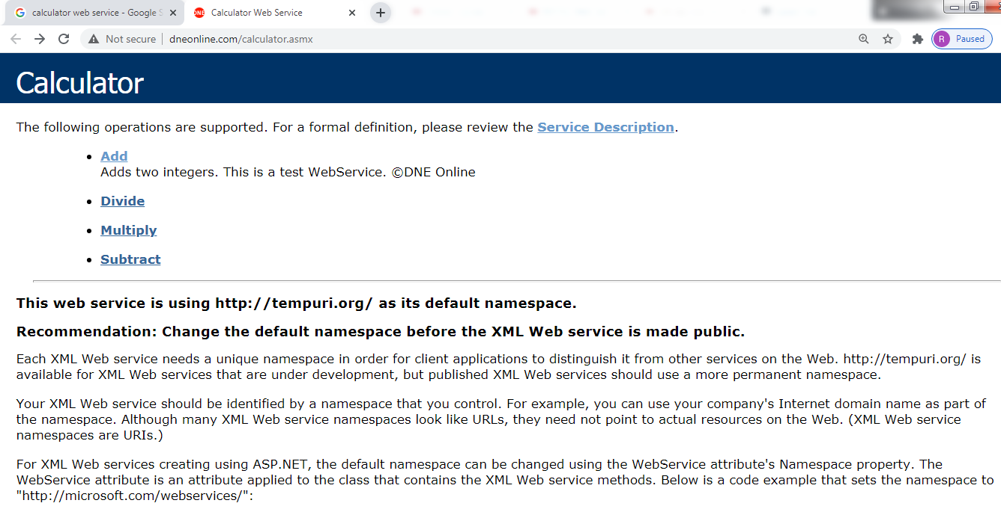
SOAP requests with Postman
http://www.dneonline.com/calculator.asmx

